Slide 1
AND / OR GATE
Basic Electronics

Slide 2

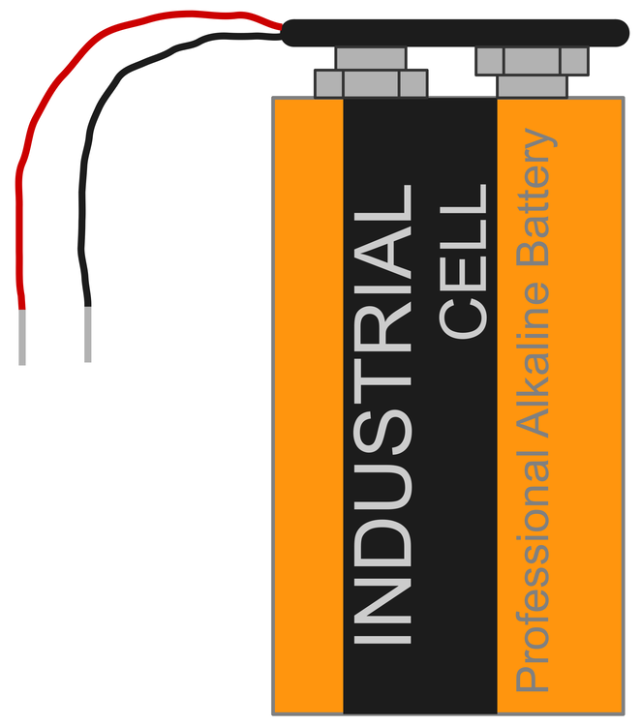
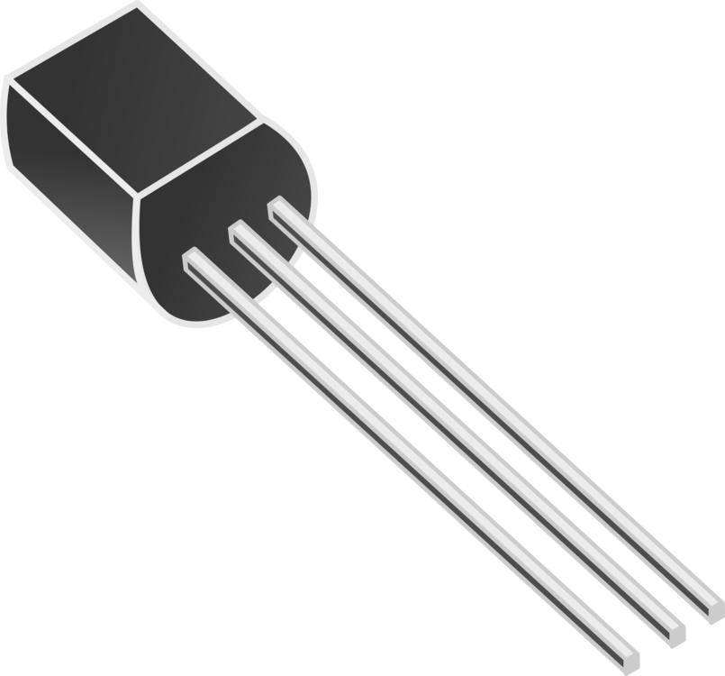
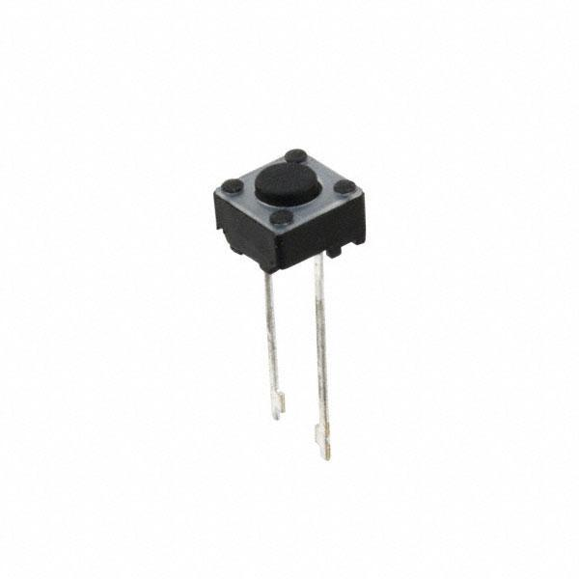
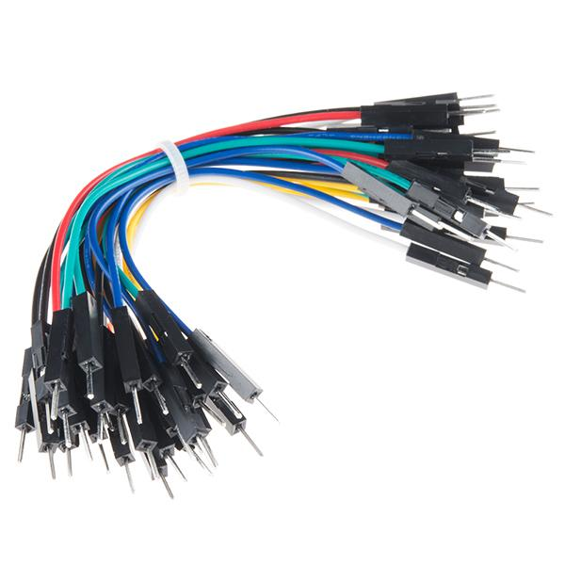
Components used to make these circuits
10k Ohm Resistor x 2
Transistors x 2
9 volts battery
1k Ohm Resistor
Push Button x 2
Jumper wires

Slide 3

Led

Slide 4
AND Gate Schematic
And gate schematic diagram

Slide 5
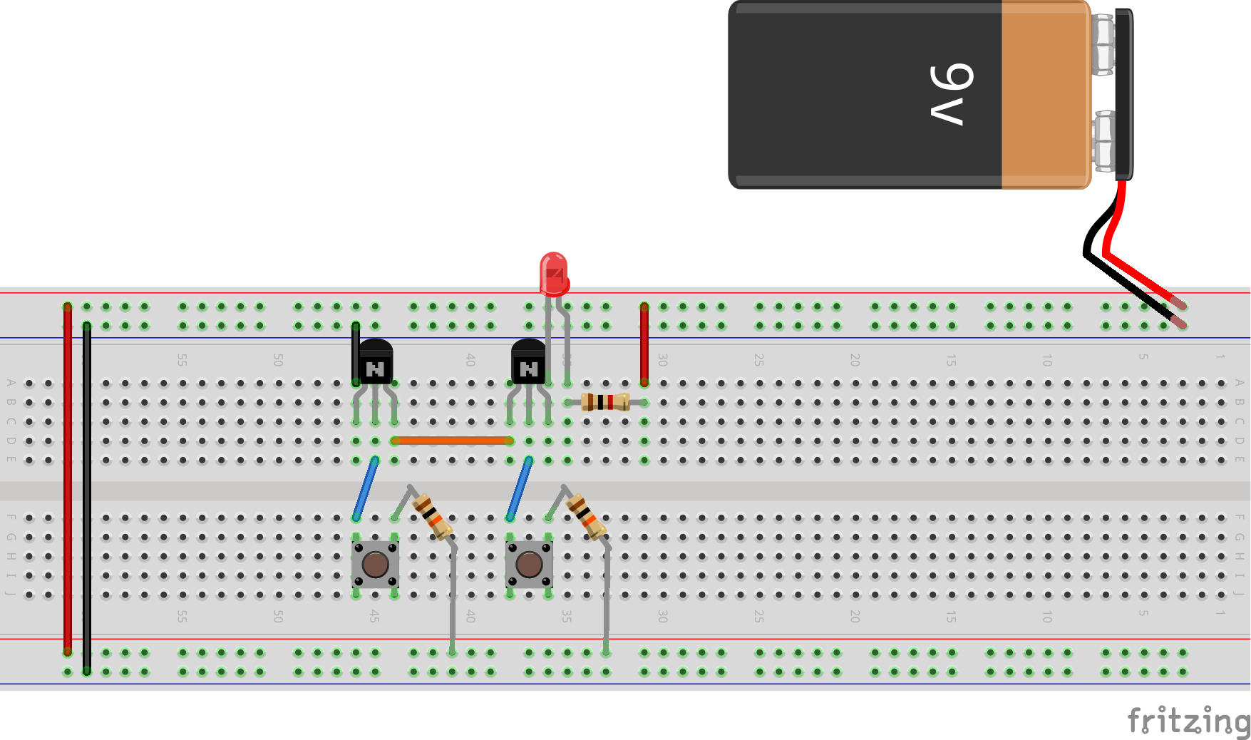
AND GATE
Circuit Diagram

Slide 6
OR Gate Schematic
OR gate schematic diagram

Slide 7
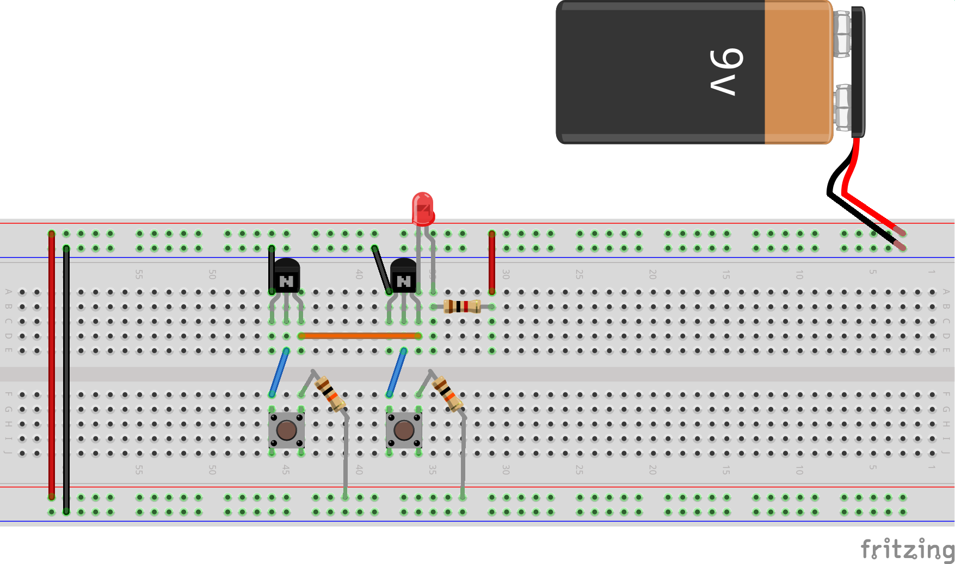
OR GATE
Circuit Diagram

Slide 8
Post the video of your circuit on Aiot group with your name and class timings.

